Slide 1

MINI PROJECT OBJECT DETECTION AND CLASSIFICATION APP
Submitted By -
Devarsh Raj (191500259)
Under the Supervision of Mr. Amir Khan
Department of Computer Engineering & Applications

Slide 2
OUTLINE
WORKING
ARCHITECTURE
SCREENSHOT AND OUTPUT

Slide 3
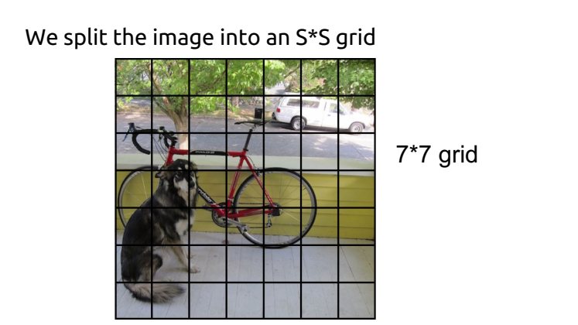
WORKING

Slide 4
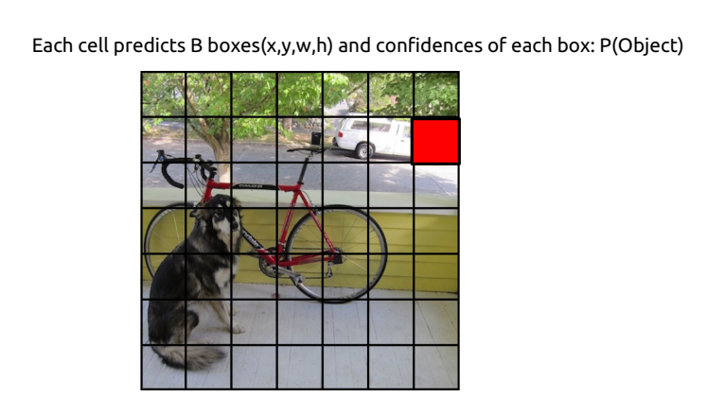

Slide 5
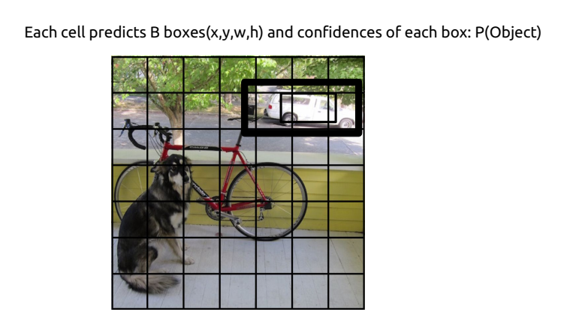

Slide 6
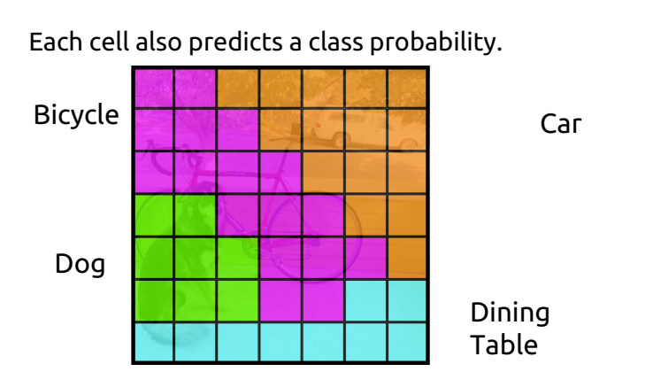

Slide 7
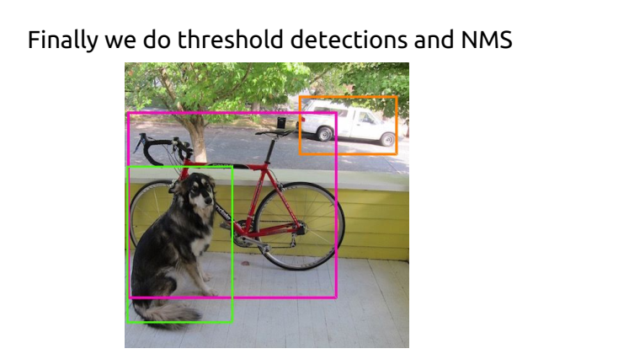

Slide 8
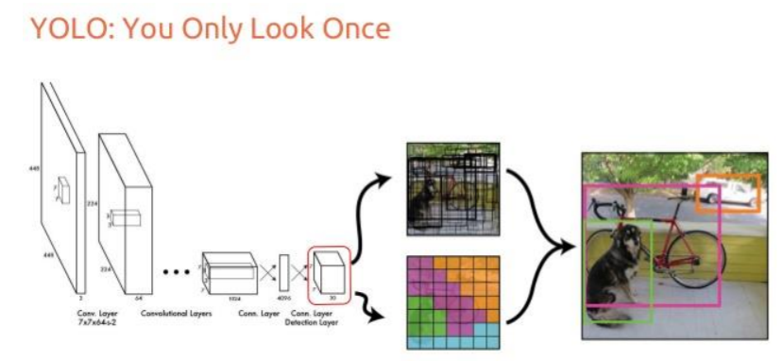
ARCHITECTURE

Slide 9
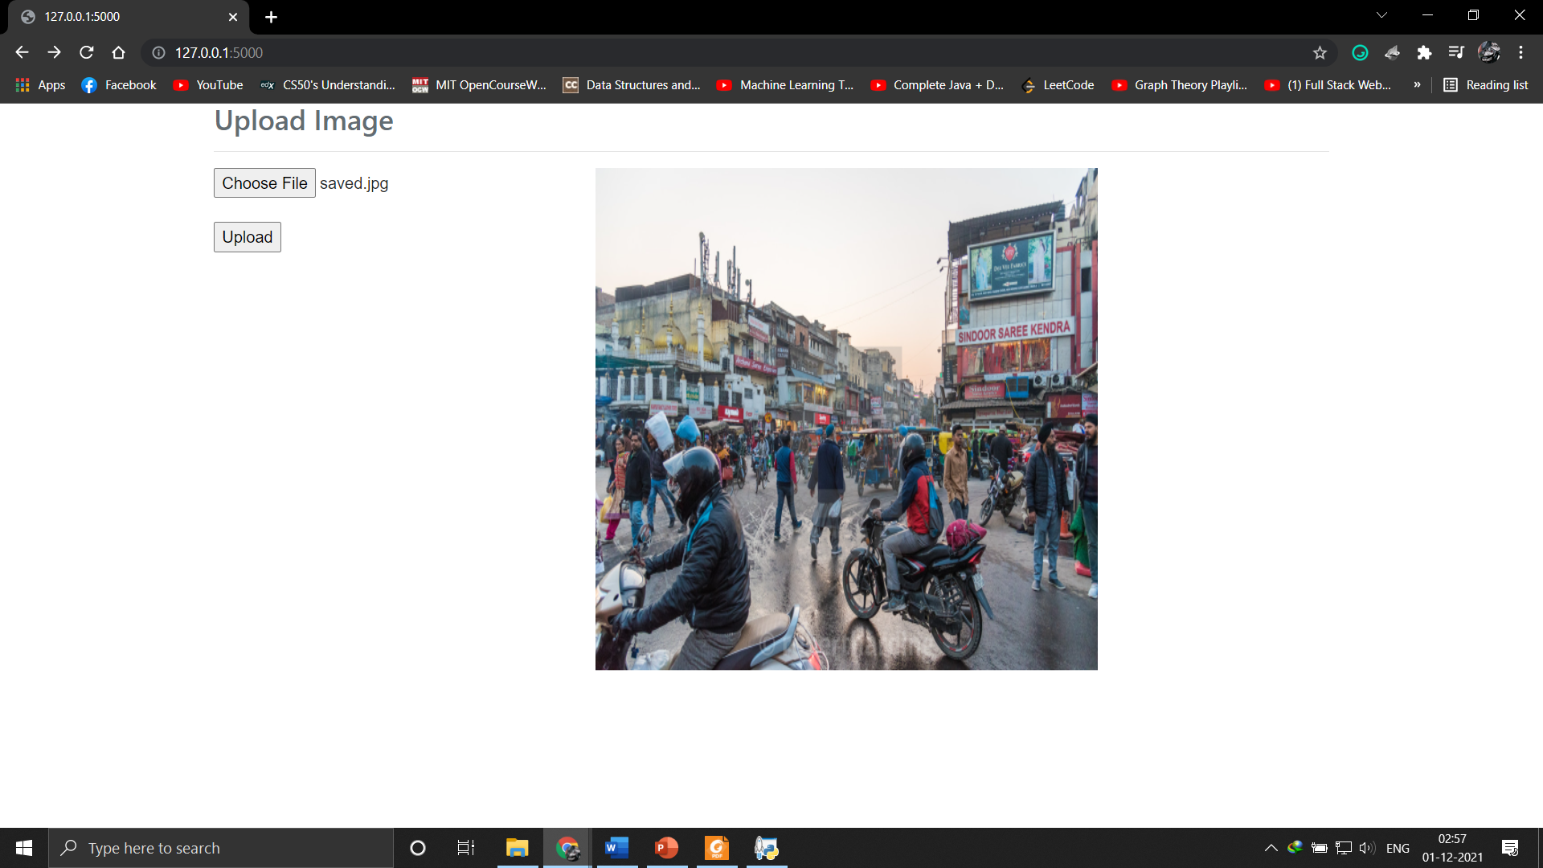
SCREENSHOTS

Slide 10
